Slide 1
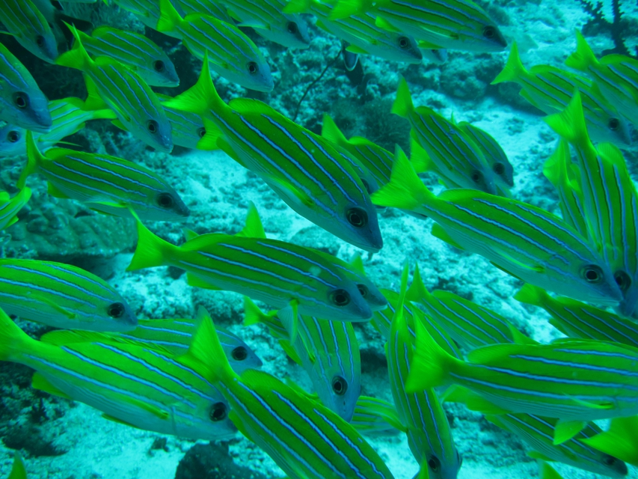



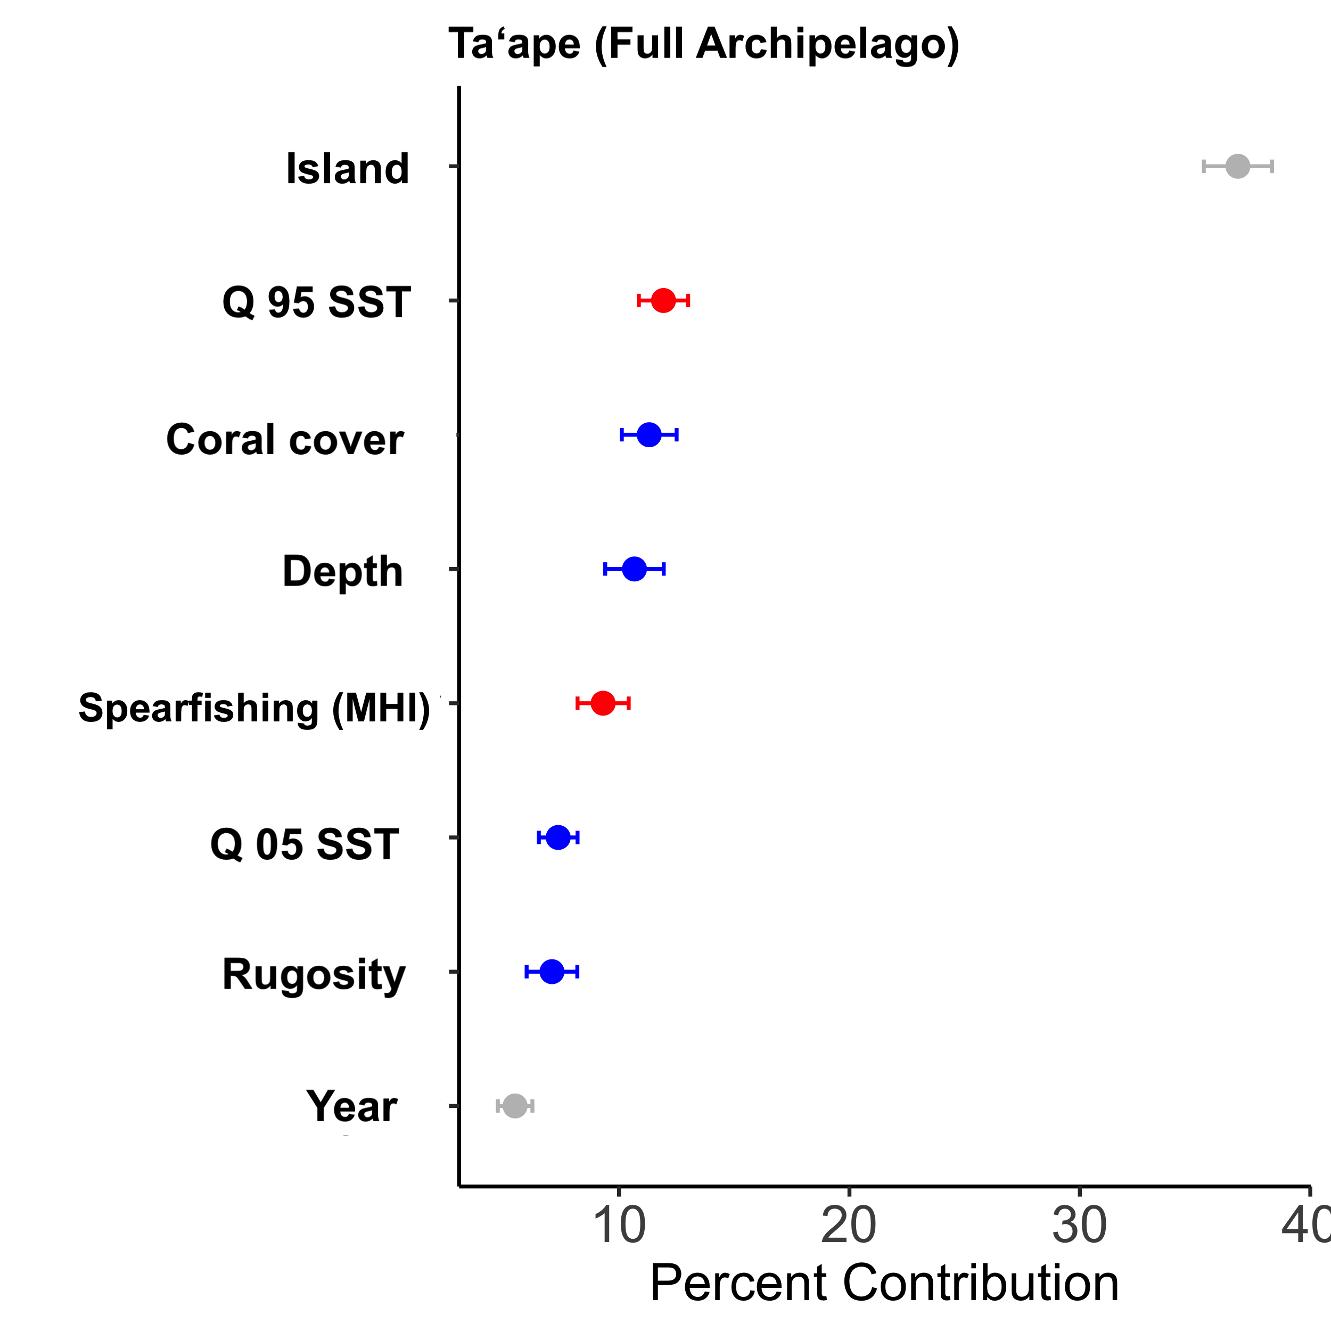
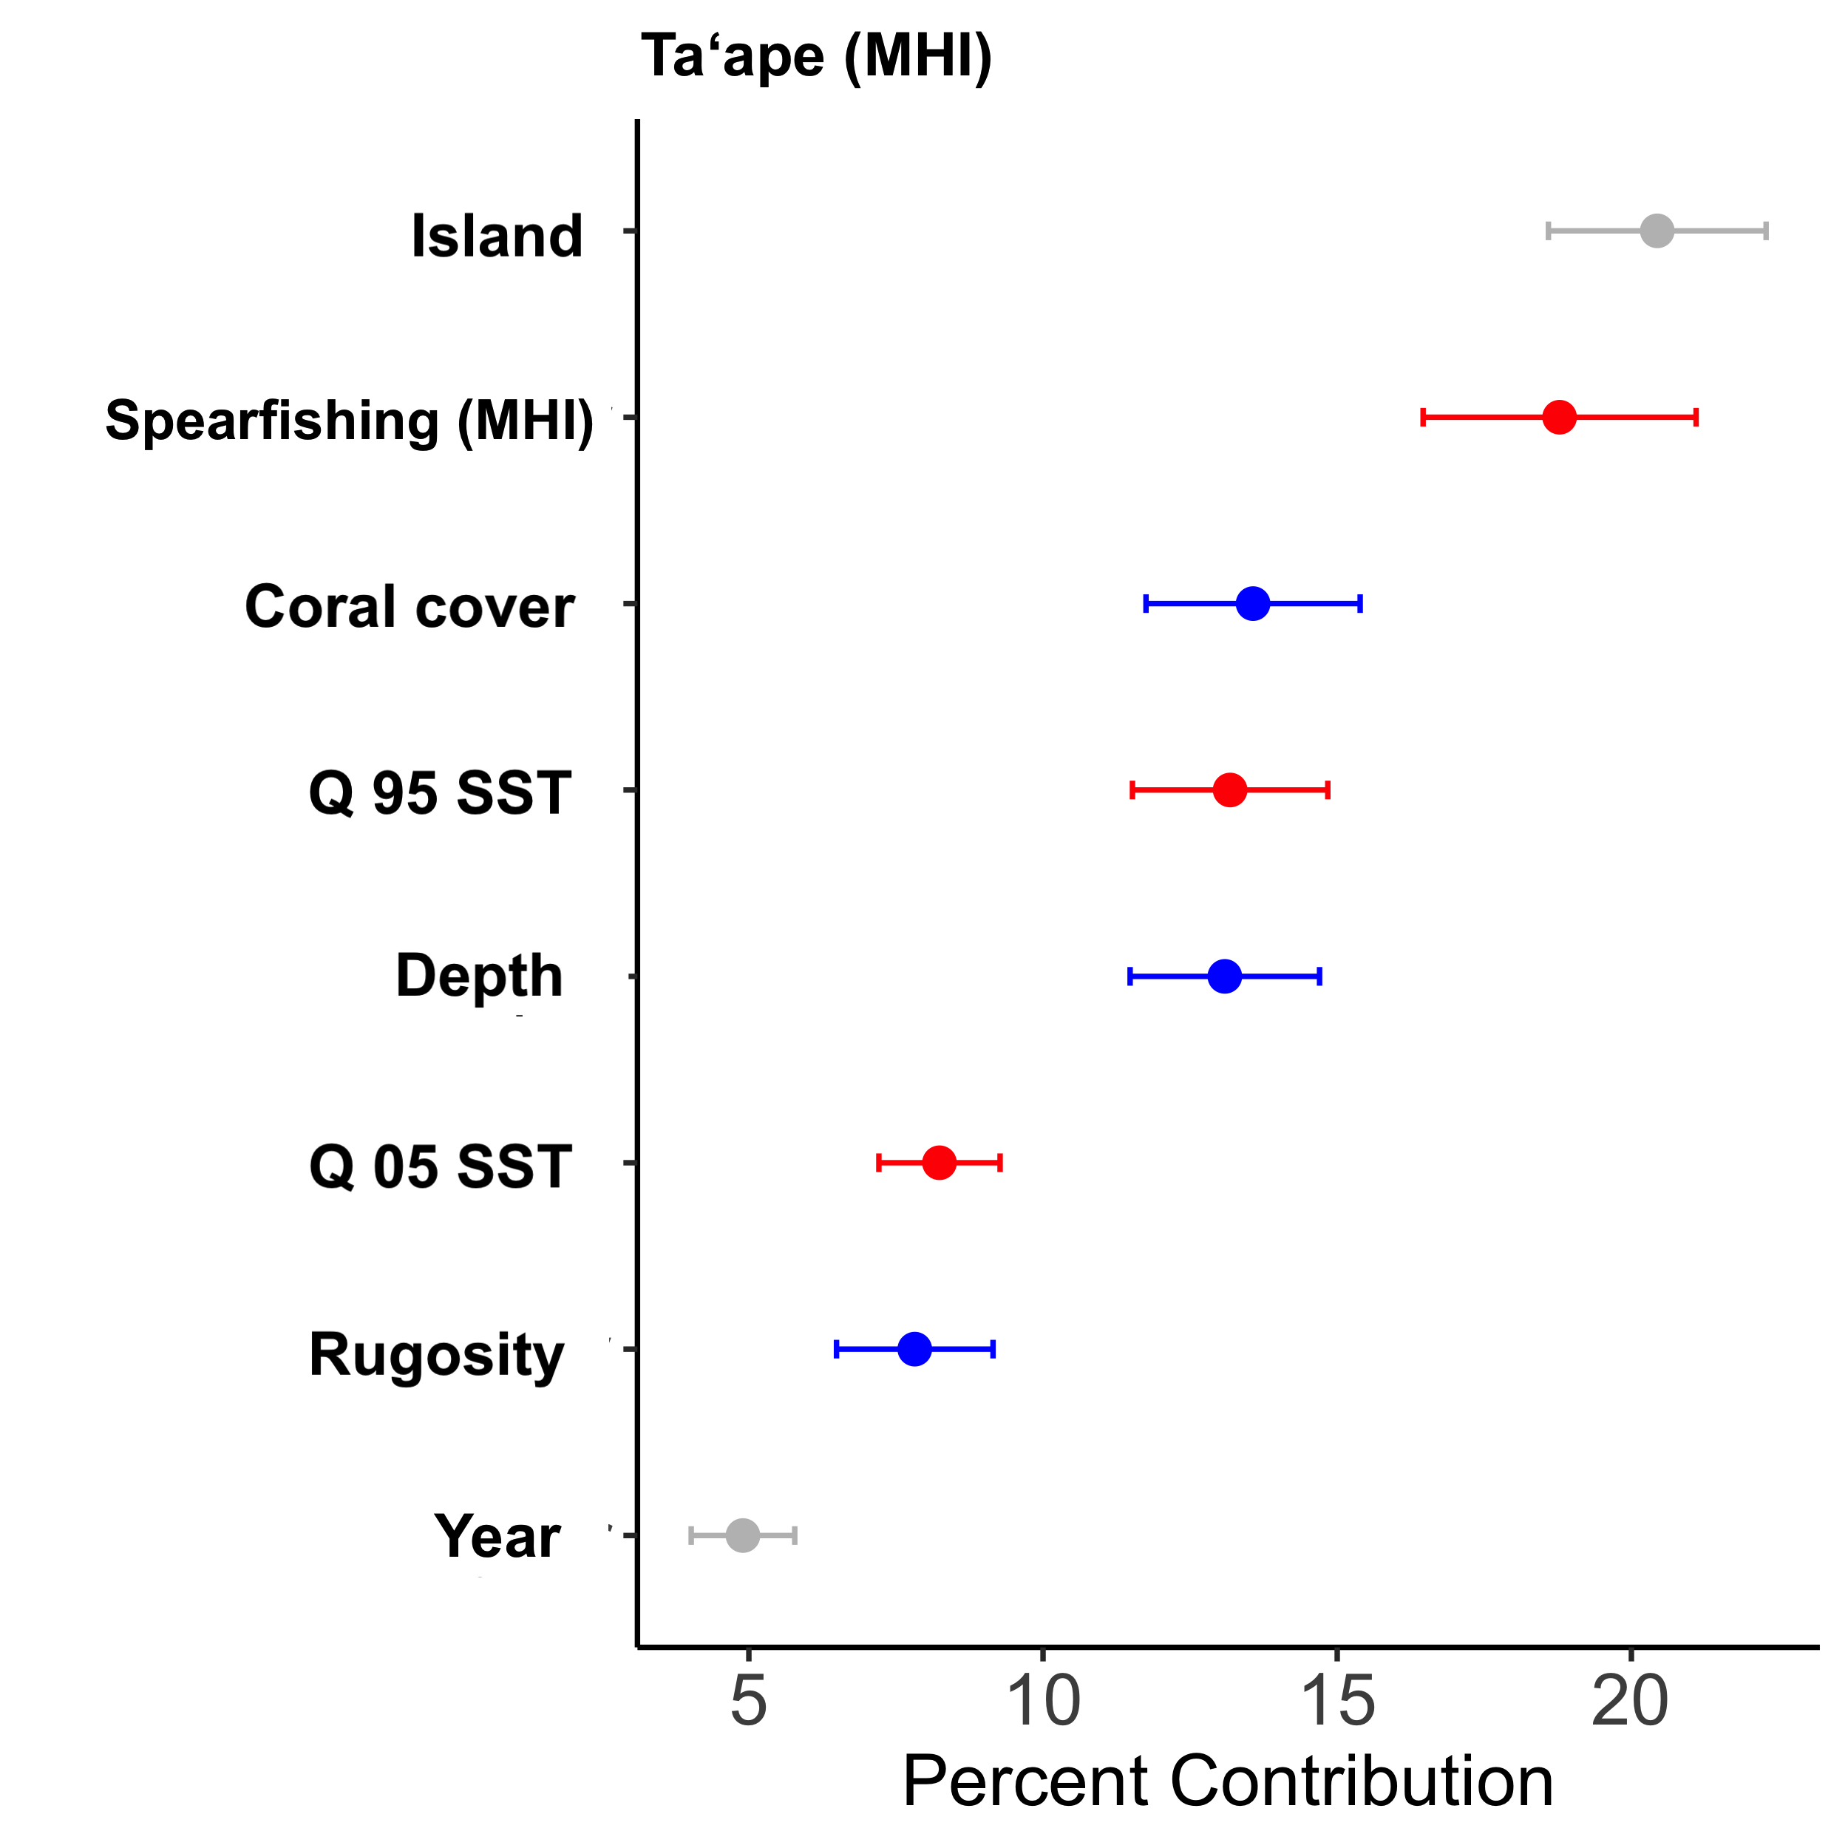
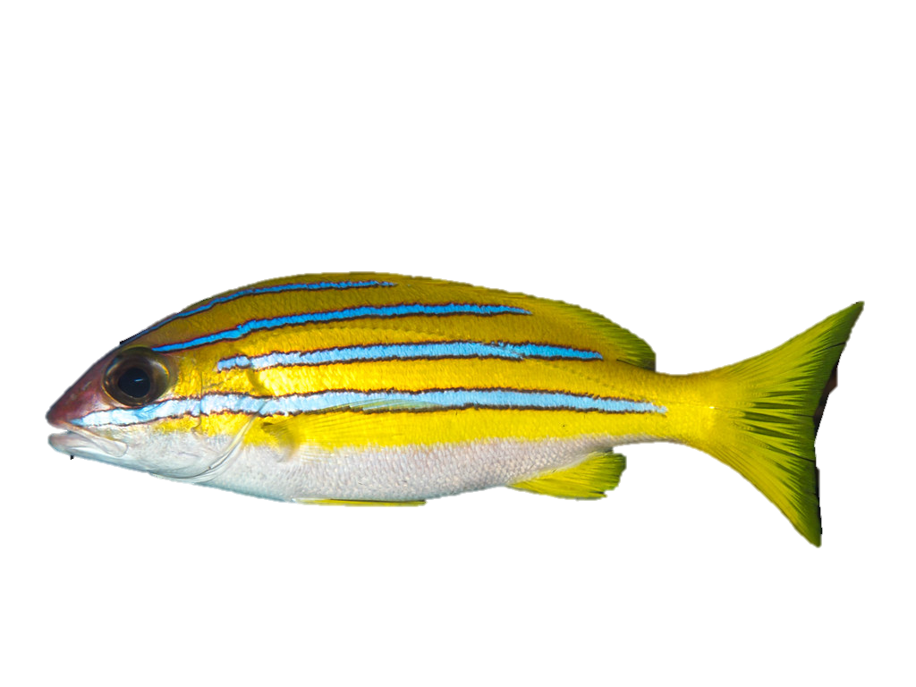
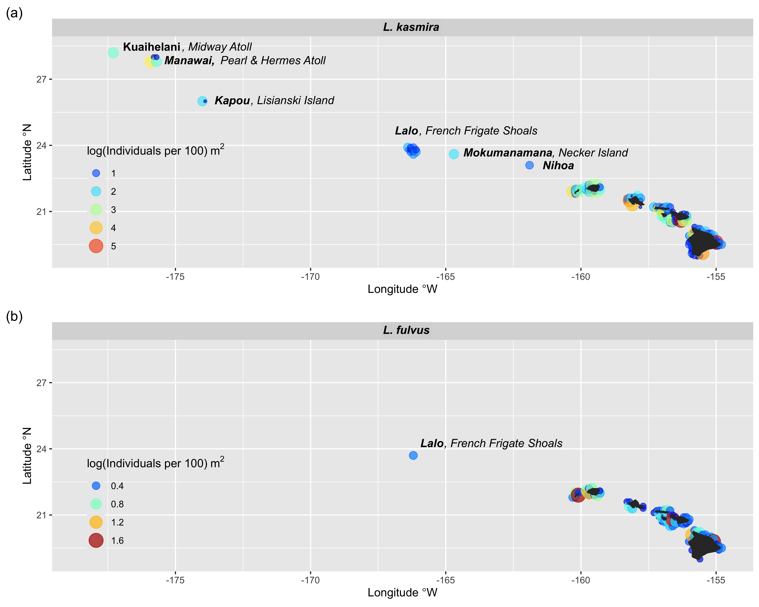
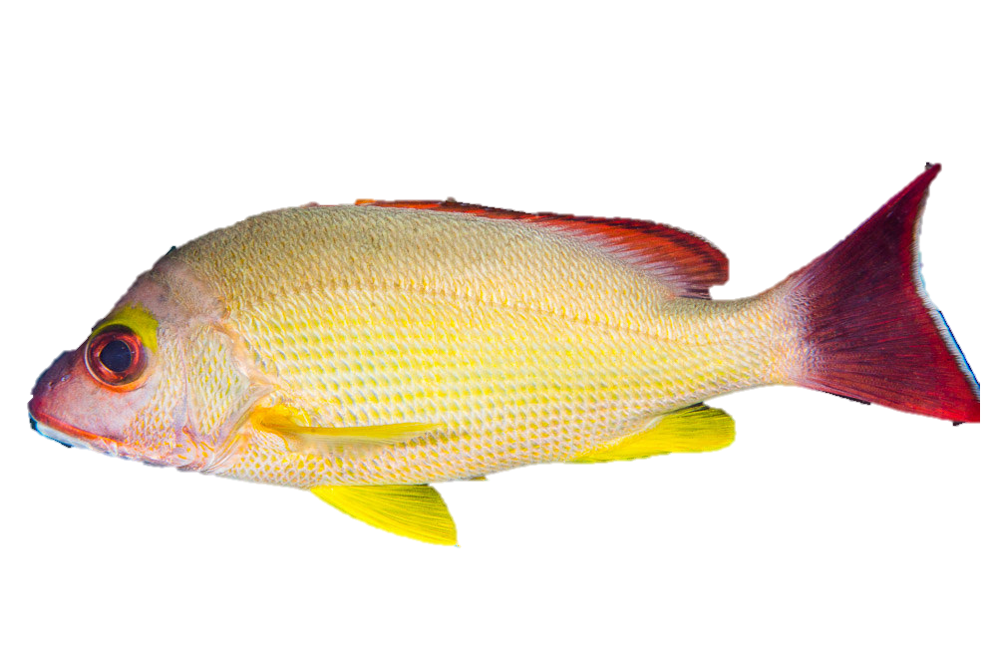
Species Distribution Modeling of Non-Native Snappers (Lutjanus spp.) in the Hawaiian Archipelago
Maya S. Otsu^{1*}, Justin J. Suca^{2,3,4}, Jessica N. Perelman^{3,4}, Kisei R. Tanaka⁴ and Lillian J. Tuttle Raz⁵
¹Marine Biology Graduate Program and Hawaiʻi Cooperative Fishery Research Unit,
University of Hawaiʻi at Mānoa, otsumaya@hawaii.edu*,
²University of Hawaiʻi at Mānoa, Department of Oceanography,
³Cooperative Institute for Marine and Atmospheric Research,
⁴NOAA Pacific Islands Fisheries Science Center,
⁵U.S. Geological Survey, Hawaiʻi Cooperative Fishery Research Unit, University of Hawaiʻi at Hilo
BACKGROUND
PRELIMINARY RESULTS
Bluestripe Snapper or Taʻape (Lutjanus kasmira) and Blacktail Snapper or Toʻau (L. fulvus) were introduced to Hawaiʻi in the 1950ʻs from French Polynesia for fisheries enhancement.¹
Both species are loosely considered “invasive” despite mixed evidence of competition with and predation on native species.
L. kasmira observed at shallow waters at all islands/atolls of the Main Hawaiian Islands (MHI) and Northwestern Hawaiian Islands (NWHI) except ʻŌnū (Gardner Pinnacles), Kamole (Laysan Island), and Kamokuokamohoaliʻi (Maro Reef)². Not observed at mesophotic depths (45-100 m) beyond Lalo (French Frigate Shoals), where reefs are dominated by endemic fish³ (Fig. 1).
L. fulvus observed in shallow waters (<45 m) only, up to Lalo (Fig. 1).
OBJECTIVES
45 m
100 m
45 m
100 m
OBJECTIVE
Quantify how environmental and anthropogenic variables drive differential distribution patterns between L. kasmira and L. fulvus and how the patterns differ across spatial and temporal scales.
Predictor | Metric | Resolution | Justification
Sea Surface Temperature (SST)⁶ | Q 05 | Annual, 1 km 2003-2021 | Thermal preference, tolerance
 | Q 95 | Annual, 1 km | Upper thermal limit, heat event
Chlorophyll a (Chla)⁷ | Mean | Monthly, 5 km 1997-present | Food availability/productivity
Depth⁸ | Meters | At survey site | Depth constraints, temperature gradients
Rugosity^{9, 10, 11} | SD of bathymetry | Climatology 0.1 km (MHI) 0.5 km (MHI & NWHI) 0.5 km (MHI) 0.6 km (NWHI) | Habitat preference
Coral cover⁸ | % cover | -- | Habitat preference
Spearfishing effort¹³ (Boat- & shore-based) | Hours/ha | -- | Human fishing pressure effects on populations
Effluent⁸ | g/km²/day | -- | Water quality, habitat disturbance
Nearshore sediment¹³ | Ton/ha/yr | 0.5 km | Reef degradation, changes in temp/salinity
Island⁸ | Degrees | -- | Temperature gradients
Year⁸ | -- | -- | Annual variability

